Slide 1
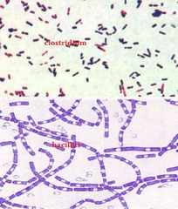
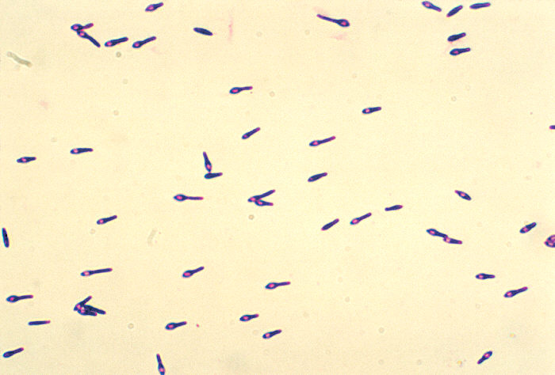
Gram-Positive Rods
Gram-positive spore-forming bacilli
Clostridia and Bacillus
^{7th} Lec. Bacteriology
By: lec. Dr.Thanaa Rasheed

Slide 2
Gram-Positive Rods
There are four medically important genera of gram-positive rods:
Clostridium, Bacillus, Corynebacterium, and Listeria.
Bacillus and Clostridium form spores, whereas Corynebacterium and Listeria do not. Members of the genus Clostridium are anaerobic, whereas those of the genus Bacillus are aerobic.

Slide 3
Clostridium species
Introduction
These bacilli are ubiquitous, and because they form spores, they are resistant to heat and disinfectants and can survive in the environment for many years.

Slide 4
Characteristics:
Clostridia are large gram-positive rods, anaerobic, spore-forming, motile and possess peritrichous flagella,
Most species are soil saprophytes but a few are pathogens to human.
They inhabit human and animal intestine, soil, water decaying animal and plant matter.
Spores of clostridia are wider than the diameter of organism and located centrally, subterminally and terminally.
The genus Clostridium is extremely heterogeneous and more than 190 species have been described.

Slide 5
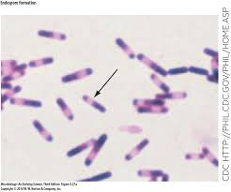
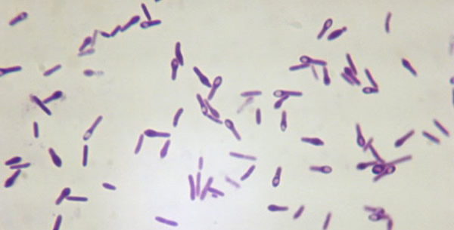
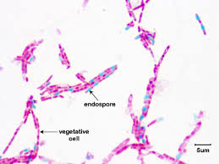
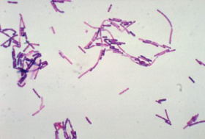

Slide 6
Characteristics:
Culture: Clostridia are growing well under anaerobic conditions on the blood-enriched media; a few species are aerotolerant.
Colony Forms: Some clostridia produce large raised colonies (eg, C perfringens); others smaller colonies (eg, C tetani). Some clostridia form colonies that spread on the agar surface.
Many clostridia produce a zone of hemolysis on blood agar. C perfringens characteristically produces a double zone of hemolysis around colonies.
Biochemical Characteristics: Clostridia can ferment a variety of sugars; many can digest proteins. Milk is turned acid by some and digested by others and undergoes "stormy fermentation" (ie, clot torn by gas) with a third group (eg, C perfringens).
Various enzymes are produced by different species.
Antigenic Characteristics: Clostridia share some antigens but also possess specific soluble antigens that permit grouping by precipitin tests.

Slide 7
Diseases
Clostridia cause several important toxin-mediated diseases:
Clostridia that produce non invasive infections Clostridium botulinum Botulism
Clostridium tetani Tetanus
Clostridia that produce invasive infections
Clostridium perfringens Gas gangrene
Clostridium difficile Pseudomembranous colitis.

Slide 8
Clostridium botulinum
C. botulinum, which causes botulism
Epidemiology
Is worldwide in distribution; it is found in soil and occasionally in animal feces.
Types of C botulinum are distinguished by the antigenic type of toxin they produce.
Spores of the organism are highly resistant to heat, withstanding 100°C for several hours. Heat resistance is diminished at acid pH or high salt concentration

Slide 9
Epidemiology
Germination of spores and growth of C botulinum can occur in a variety of alkaline or neutral foodstuffs when conditions are sufficiently anaerobic. If spores contaminate food, they may convert to the vegetative state, multiply, and produce toxin in storage. This may occur with no change in food taste, color, or odor.
A chief risk factor for botulism lies in home-canned foods, particularly string beans, corn, peppers, olives, peas, and smoked fish or vacuum-packed fresh fish in plastic bags.
Toxic foods may be spoiled and rancid, and cans may "swell," or the appearance may be innocuous.

Slide 10
Epidemiology
Inadequately heated home-canned foods are most common source.
Infant and wound botulism results when the toxin is produced endogenously, beginning with environmental spores that are either ingested or contaminate wounds.
Botulinum toxin is the most potent toxin known in nature.
Botulinum toxin is considered to be a major agent for bioterrorism and biologic warfare.
Rare strains of C butyricum and C baratii have also been shown to produce botulinum neurotoxin and cause botulism in humans. Those strains that produce toxins E and F are associated with infant botulism.

Slide 11
Toxins
Pathogenesis
During the growth of C botulinum and during autolysis of the bacteria, toxin is liberated into the environment.
Seven antigenic varieties of toxin (A–G) are known.
Types A, B, and E (and occasionally F) are the principal causes of human illness.
Types A and B have been associated with a variety of foods and type E predominantly with fish products.
Type D causes botulism in mammals.
Botox is a commercial preparation of exotoxin A used to remove wrinkles on the face. Minute amounts of the toxin are effective in the treatment of certain spasmodic muscle disorders such as torticollis, "writer's cramp," and blepharospasm.

Slide 12
Mechanism of action of toxin
When C botulinum grows under the anaerobic conditions, it elaborates a family of neurotoxins of extraordinary toxicity.
Is absorbed from the gut and and reaches its neuromuscular junction target via the bloodstream. binds to receptors of presynaptic membranes of motor neurons of the peripheral nervous system and cranial nerves.
Botulinum toxin is an enzyme (metalloproteinase) that acts at neuromuscular junctions which effectively block the release of the neurotransmitter acetylcholine from vesicles at the presynaptic membrane of the synapse.
Because acetylcholine mediates activation of motor neurons, the blockage of its release causes lack of muscle contraction resulting in flaccid paralysis of the motor system.
The lethal dose for a human is probably about 1–2 µg/kg.
The toxins are destroyed by heating for 20 minutes at 100°C.

Slide 13
Pathogenesis
Food-borne botulism is an intoxication, not an infection.
The specific disease manifestations depend on the specific nerves to which the circulating toxin binds.
Cardiac arrhythmias and blood pressure instability are believed to be due to effects of the toxin on the autonomic nervous system.

Slide 14
Clinical Findings
Symptoms begin 18–24 hours after ingestion of the toxic food
Visual disturbances (incoordination of eye muscles, double vision)
Inability to swallow, and speech difficulty.
Signs of bulbar paralysis are progressive.
Death occurs from respiratory paralysis or cardiac arrest.
Gastrointestinal symptoms are not regularly prominent.
There is no fever.
The patient remains fully conscious until shortly before death.
The mortality rate is high.
Patients who recover do not develop antitoxin in the blood.

Slide 15
Infant Botulism
The organism is apparently introduced on weaning or with dietary supplements, especially honey, which is virtually impossible to sterilize.
The infants in the first months of life develop poor feeding, weakness, and signs of paralysis (floppy baby).
Infant botulism may be one of the causes of sudden infant death syndrome.
C botulinum and botulinum toxin are found in feces but not in serum.
Wound Botulism
Very rarely, wounds infected with other organisms may allow C. botulinum to grow.
Wound botulism in parenteral users of cocaine and maxillary sinus botulism in intranasal users of cocaine has been reported.
Disease similar to that from food poisoning may develop, or it may begin with weakness localized to the injured extremity.

Slide 16
Diagnostic Laboratory Tests
Clostridia are large gram-positive rods
Culture: Clostridia are growing well under anaerobic conditions on the blood-enriched media.
Toxin can often be demonstrated in serum from the patient, and toxin may be found in leftover food.
Mice injected intraperitoneally die rapidly.
The antigenic type of toxin is identified by neutralization with specific antitoxin in mice.
In infant botulism, C botulinum and toxin can be demonstrated in bowel contents but not in serum.
Toxin may be demonstrated by passive hemagglutination or radioimmunoassay.

Slide 17
Treatment
Potent antitoxins to three types of botulinum toxins have been prepared in horses. Since the type responsible for an individual case is usually not known, trivalent (A, B, E) antitoxin must be promptly administered intravenously with customary precautions.
Adequate ventilation must be maintained by mechanical respirator, if necessary.
These measures have reduced the mortality rate from 65% to below 25%.
Antimicrobial agents are given only to patients with wound botulism.
Although most infants with botulism recover with supportive care alone, antitoxin therapy is recommended.

Slide 18
Prevention, & Control
The canned or preserved foods must be sufficiently heated to ensure destruction of spores or must be boiled for 20 minutes before consumption.
Strict regulation of commercial canning has largely overcome the danger of widespread outbreaks.

Slide 19
Clostridium tetani
C. tetani, which causes tetanus
Epidemiology
Is worldwide in distribution in the soil and in the feces of horses and other animals.
Several types of C tetani can be distinguished by specific flagellar antigens. All share a common O (somatic) antigen, which may be masked, and all produce the same antigenic type of neurotoxin, tetanospasmin.

Slide 20
Epidemiology
The route of infection:
Spores are introduced into small wounds (eg, a puncture wound with a splinter) contaminated with soil or foreign bodies.
In many developing countries, the majority of tetanus cases occur in recently delivered infants when the umbilical cord is severed or bandaged in a nonsterile manner.
Similarly, tetanus may follow an unskilled abortion, scarification rituals, female circumcision, and even surgery performed with nonsterile instruments or dressings.

Slide 21
Toxin
The vegetative cells of C tetani produce the toxin tetanospasmin that is cleaved by a bacterial protease into two peptides linked by a disulfide bond.
The toxin initially binds to receptors on the presynaptic membranes of motor neurons.
It then migrates by the retrograde axonal transport system to the cell bodies of these neurons to the spinal cord and brain stem.
The toxin diffuses to terminals of inhibitory cells, including both glycinergic interneurons and aminobutyric acid-secreting neurons from the brain stem.
The toxin degrades synaptobrevin, a protein required for docking of neurotransmitter vesicles on the presynaptic membrane.
Release of the inhibitory glycine and γ-aminobutyric acid is blocked, and the motor neurons are not inhibited. Hyperreflexia, muscle spasms, and spastic paralysis result.

Slide 22
Toxin
Extremely small amounts of toxin can be lethal for humans.
The toxin is heat-labile, antigenic, readily neutralized by antitoxin, and rapidly destroyed by intestinal proteases.
Treatment with formaldehyde yields a nontoxic product or toxoid that retains the antigenicity of toxin and thus stimulates production of antitoxin.

Slide 23
Pathogenesis
C tetani is not an invasive organism. The infection remains strictly localized in the area of devitalized tissue (wound, burn, injury, umbilical stump, surgical suture) into which the spores have been introduced. The volume of infected tissue is small, and the disease is almost entirely a toxemia.
Germination of the spore and development of vegetative organisms that produce toxin are aided by
Necrotic tissue (2) Calcium salts, and (3) Associated pyogenic infections.
All of which aid establishment of low oxidation-reduction potential.
The toxin released from vegetative cells reaches the central nervous system and rapidly becomes fixed to receptors in the spinal cord and brain stem and exerts the actions described above.

Slide 24
Clinical Findings
The incubation period may range from 4–5 days to as many weeks.
The disease is characterized by tonic contraction of voluntary muscles.
Muscular spasms often involve first the area of injury and infection and then the muscles of the jaw (trismus, lockjaw), which contract so that the mouth cannot be opened.
Gradually, other voluntary muscles become involved, resulting in tonic spasms. Any external stimulus may precipitate a tetanic generalized muscle spasm.
The patient is fully conscious, and pain may be intense.
Death usually results from interference with the mechanics of respiration.
The mortality rate in generalized tetanus is very high.

Slide 25
Diagnosis
The diagnosis rests on the clinical picture and a history of injury,
The primary differential diagnosis of tetanus is strychnine poisoning.
Anaerobic culture of tissues from contaminated wounds may yield C tetani, but neither preventive nor therapeutic use of antitoxin should ever be withheld pending such demonstration.
Proof of isolation of C tetani must rest on production of toxin and its neutralization by specific antitoxin.

Slide 26
Prevention & Treatment
Prevention is all-important. depends upon
Active immunization with toxoids. Aluminum-salt-adsorbed toxoids are employed.
Three injections :Initial immunization should be carried out in all children during the first year of life. another dose about 1 year later A "booster" injection of toxoid is given upon entry into school. Thereafter, "boosters" can be spaced 10 years apart to maintain serum levels of more than 0.01 unit antitoxin per milliliter.
In young children, tetanus toxoid is often combined with diphtheria toxoid and acellular pertussis vaccine (DTP).
When a previously immunized individual sustains a potentially dangerous wound, an additional dose of toxoid should be injected to restimulate antitoxin production.
Immunization efforts also focused on pregnant women,

Slide 27
Prevention & Treatment
2. Proper care of wounds contaminated with soil, etc;
3. Prophylactic use of antitoxin; 250–500 units of human antitoxin (tetanus immune globulin) gives adequate systemic protection for 2–4 weeks.
Sometimes they are given very large doses of antitoxin (3000–10,000 units of tetanus immune globulin) intravenously in an effort to neutralize toxin that has not yet been bound to nervous tissue.
But the efficacy of antitoxin for treatment is doubtful except in neonatal tetanus, where it may be lifesaving.
4. Administration of penicillin.
5. Patients who develop symptoms of tetanus should receive muscle relaxants, sedation, and assisted ventilation.
6. Surgical debridement is vitally important because it removes the necrotic tissue that is essential for proliferation of the organisms.

Slide 28


